Slide 1
SmartGuide: A smart campus guide using BLE based indoor localization
Tooba Naseer (2016-CE-72)
Rida Mahmood (2016-CE-54)
Ayesha Jabbar (2016-CS-159)
Rabeya Hamood (2016-CE-81)

Slide 2
Idea Defence Presentation
Supervisor
Dr. Sheikh Faisal Rasheed
Co-Advisor
Dr. Beenish Ayesha Akram
Computer Science and Engineering Department, UET Lahore.

Slide 3
Overview of the Project Agenda
Introduction
Problem Statement
Motivation
Objectives
Scope
Existing System
Proposed System
Methodology
Possible Applications of Work
Feasibility Study
Market Survey
Limitations and Challenges

Slide 4
Introduction
Overview
Predict room level location using BLE beacons.
RSSI fingerprinting technique.
Information of current and its nearby locations on user’s mobile app.
To provide guided tour of the indoor building (CSE Dept of UET).

Slide 5
Introduction(Contd.)
Background
Why we need to initiate it?
What problems and needs it will address?

Slide 6
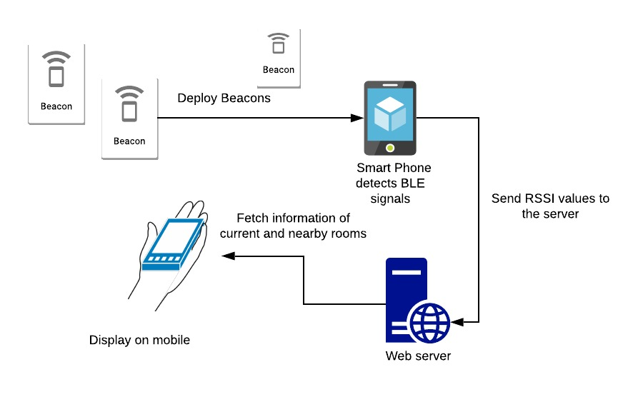
Introduction(Contd.)

Slide 7
Problem Statement
Whenever a visitor goes to university campus or visits a new place, he does not know about the specifications of that area i.e. what happens in that specific room or what courses have been taught in a particular and its nearby labs. So, we are developing a system which assists them in determining the textual and pictorial information of a particular area and its nearby locations. For this purpose, we first find the indoor location of a user by using BLE beacons and FP values, and then provide information to him automatically on his android application.

Slide 8
Motivation
Ease and leverage facility to users through android app
Provide guided tours of smart campus to visitors
Use of smart technology BLE beacons

Slide 9

Goal
Our goal is to provide ease and guidance to users regarding current and nearby locations automatically via installed application on device by estimating his indoor location. The guidance involves the textual and pictorial information.

Slide 10
Objectives
Research Objectives
Find location using RSSI fingerprinting
To monitor and provide guidelines to users
To develop an android application which provide required functionalities to users.

Slide 11
Objectives(Contd.)
Academic Objectives
This project enables us to understand the following concept
Machine learning
Networking
Android development
Front end design
Client server communication management

Slide 12
Objectives(Contd.)
Industrial Objectives
Satisfy demands of university campus exploration.
Save time and effort.
Seeking customer attention
Increase sales and profit

Slide 13
Scope of the Project
Data(FP) collection
Trained model using Machine Learning Algorithms
Smart Guided Tour
Android Application
Indoor location is CSE Department, UET Lhr.

Slide 14
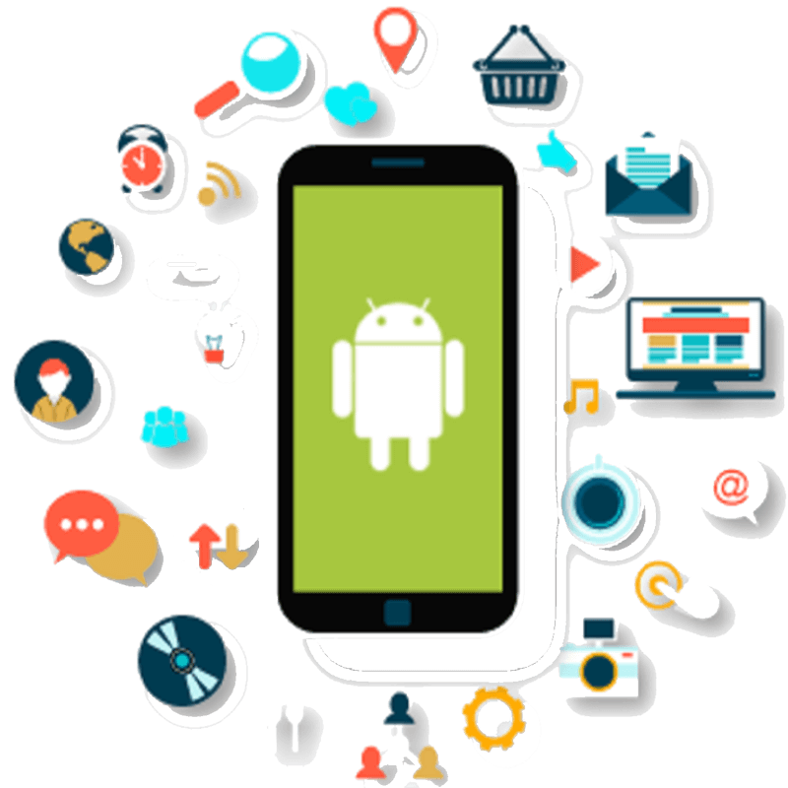
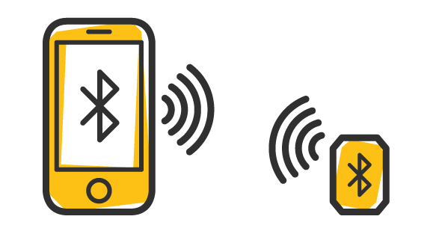
Scope of the Project(Contd.)

Slide 15
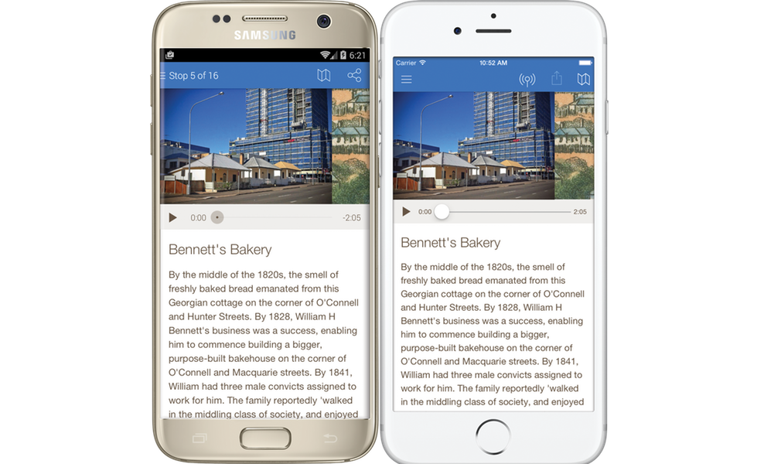
Scope of the Project(Contd.)
Smart Guide on Mobile App

Slide 16
Possible Applications of Work
Software house information
Airport assisting system
University Campus smart information system
Government small Institutes
Medical departments for awareness in hospitals

Slide 17
Existing Systems
Mobile campus tour application based on augmented reality.
Existing systems for room level prediction:
Image based indoor localization
By using capacitive sensors
By using Zigbee sensors
By using Wifi

Slide 18
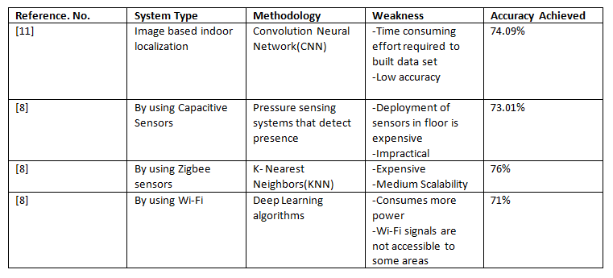
Comparison of Existing Systems

Slide 19
Drawbacks of Existing Systems
Costly Hardware Requirement
Time consuming and high effort required
More Power consumption
Obtrusiveness
Less Accurate
Wi-Fi signals are not accessible every where
Find indoor positioning for different purposes, not for university guidance

Slide 20
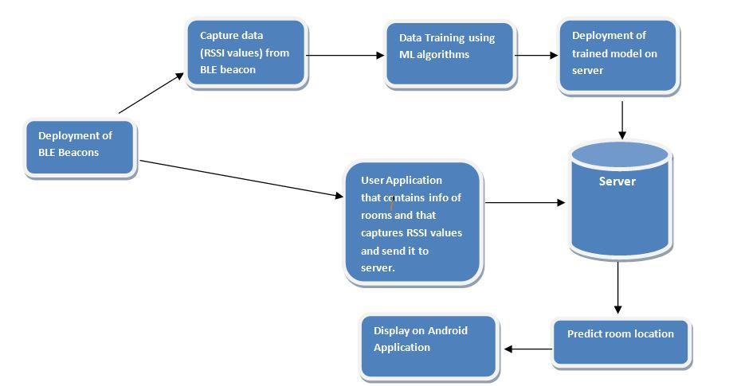
Proposed System

Slide 21
System Requirements For Developers
Hardware
Requirements
BLE Beacons
Hard Disk
Processor
RAM
Software
Requirements
Weka API
Android studio
MySQL and PHP
Windows OS for development

Slide 22
System Requirements For Users
User just need android phones in which our android application is installed

Slide 23

Feasibility Study
Technical Feasibility
Operational Feasibility
Economical Feasibility

Slide 24
Technical Feasibility
Availability of Resources
Required skill set
Advisor involvement

Slide 25
Operational Feasibility
At user end, there is no need of additional hardware
Only android application required
Visitors who are not familiar with CSE dept. are much likely to use this application.

Slide 26
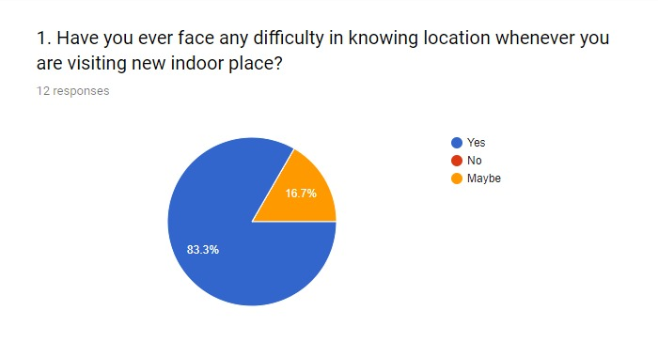
Operational Feasibility(Contd.)

Slide 27
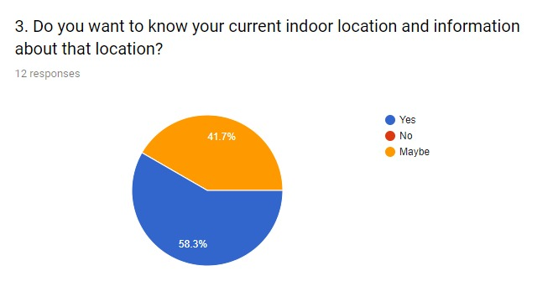
Operational Feasibility(Contd.)

Slide 28
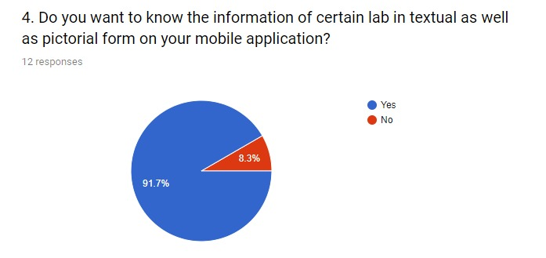
Operational Feasibility(Contd.)

Slide 29
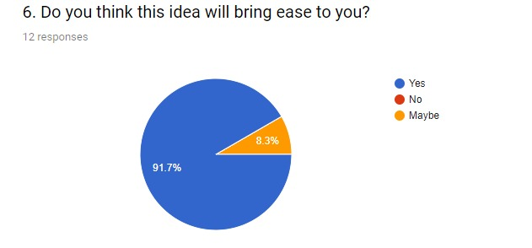
Operational Feasibility(Contd.)

Slide 30
Economic Feasibility
1 beacon = 5 USD
No. of beacons to cover
experiment area = 6
Total beacons required = 22
Publishing cost on play store = 25$ approx Rs.3,921/-

Slide 31
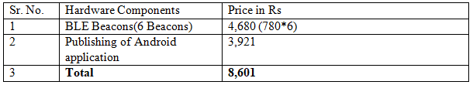
Budget Plan

Slide 32
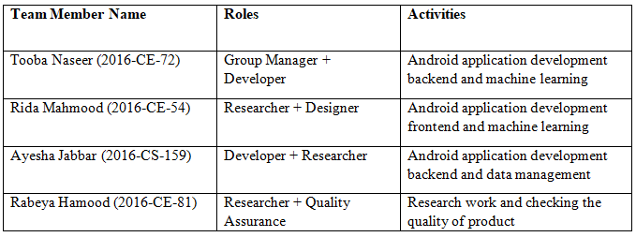
Roles and Activities of Team Members

Slide 33
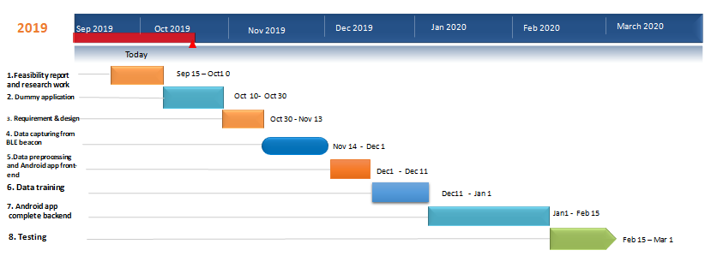
Timeline Of our Project

Slide 34
SWOT Analysis
Limitations and Challenges
Deployment of BLE beacons for indoor localization
Using Android Studio
Send mobile app data to server
Send trained data to android application

Slide 35
SWOT Analysis(Contd.)
Strengths and Opportunities
Supports android phones
Beacons are platform independent.
Bluetooth beacons are much more compatible than Wi-Fi
Weka and Android studio is open source.
User can easily find the location where he stands.

Slide 36
Thank You!

